Slide 1
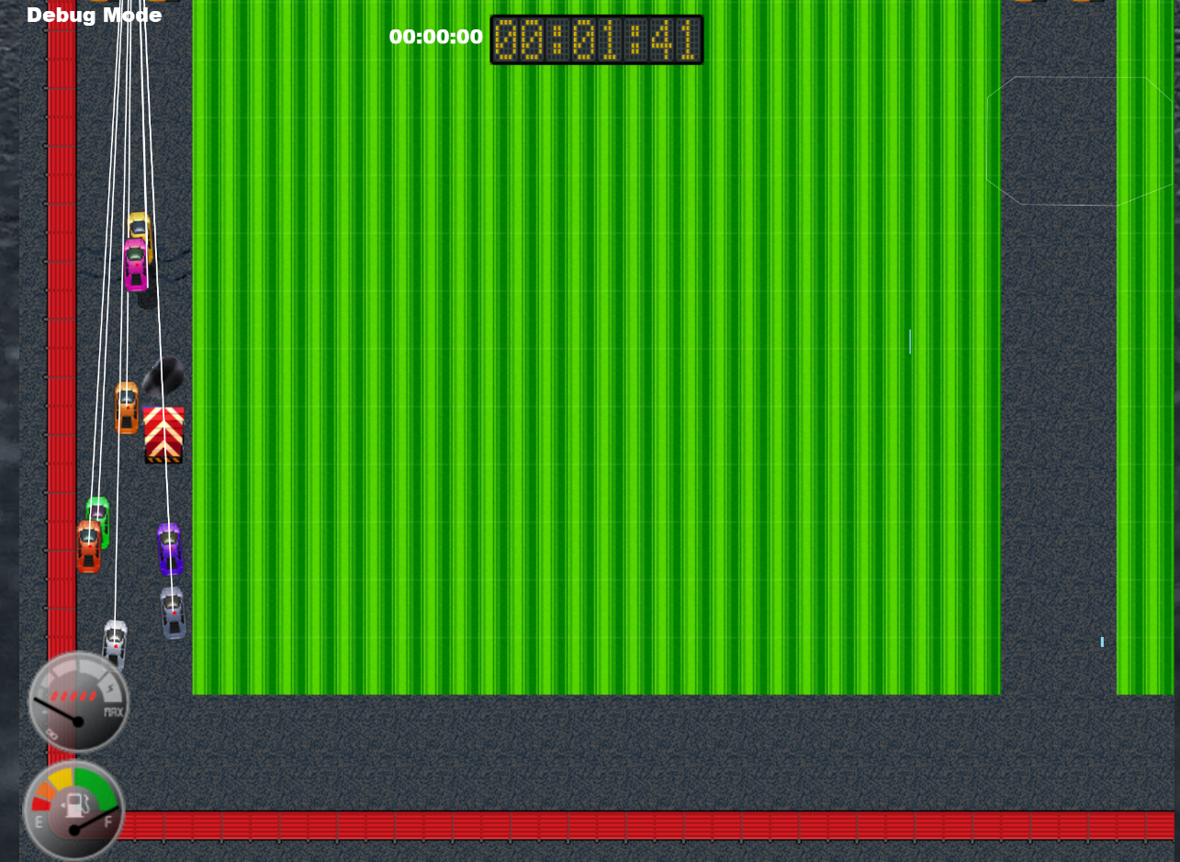
Little Racers
Pitch Date: June 22 , 2019 Week 7: 8/11/2019
Release Date: September 15, 2019 5 weeks to go!
Team Lead: Vince McKeown
21 contributors (+2)

Slide 2
Updates to Code
Chris Deleon
Finished minimap
Simon
Cam shakes when vehicle hits wall
Placeholder for health
Anthony Free
WIP: Health Bars
Shields
Vince McKeown
WIP: In Race position identifier

Slide 3
Updates to Code
Christer “McFunky Pants” Kaitila
New flames on Title Screen
Tire Tracks fixed
“Racers” occasionally sparkles
Randy Tan
Moved start lights to center of the screen.

Slide 4
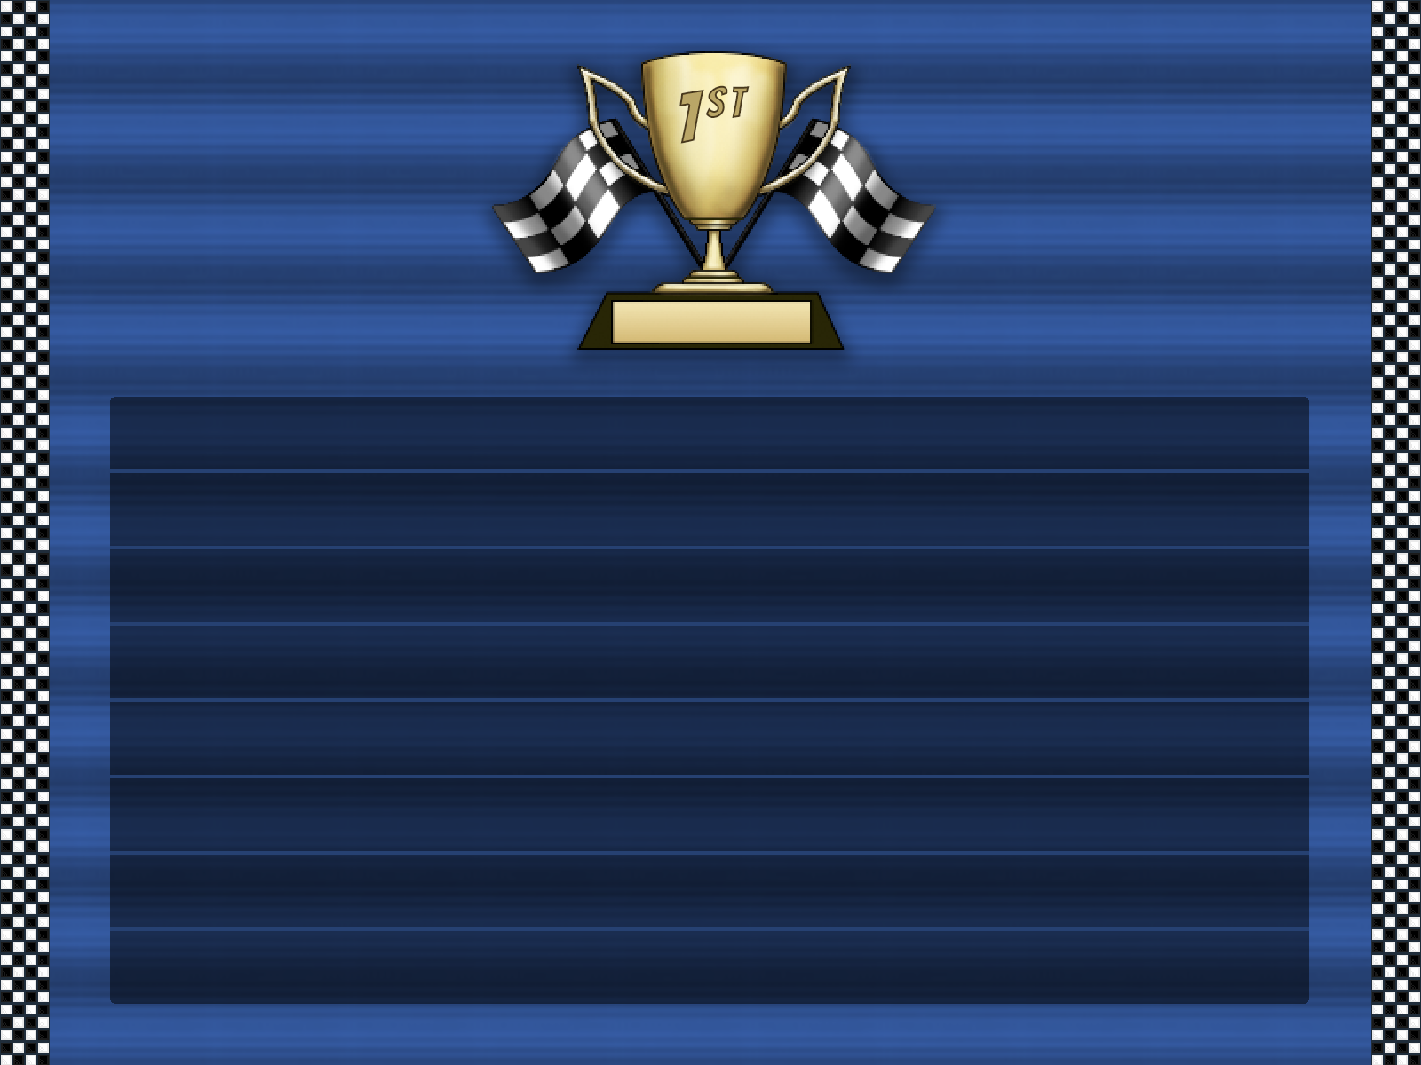
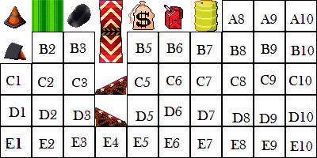
Updates to Art
Gonzalo Delgado
Jeff Hanlon

Slide 5
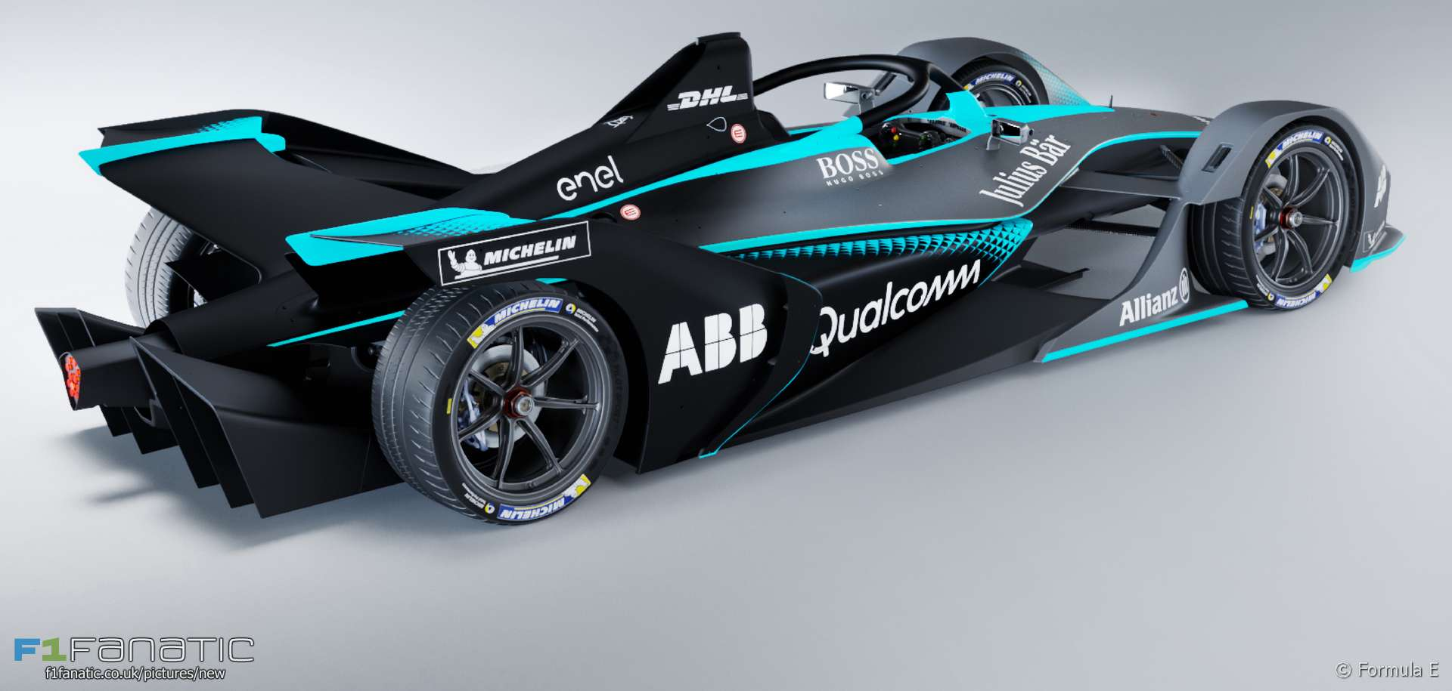
Demo
Cutover to Game

